Slide 1
NEO4J CYPHER TUTORIAL WITH PYTHON
Pattern Comprehension
Tutorial 33

Slide 2
Pattern COMPREHENSION
Pattern comprehension is a syntactic construct available in Cypher for creating a list based on matchings of a pattern. A pattern comprehension will match the specified pattern just like a normal MATCH clause, with predicates just like a normal WHERE clause, but will yield a custom projection as specified.

Slide 3
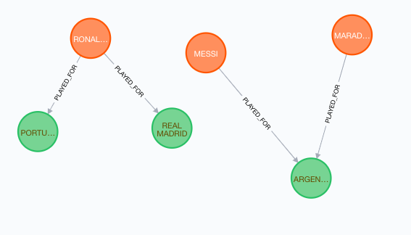
Pattern COMPREHENSION

Slide 4
Pattern COMPREHENSION
With Where clause but with expression:
MATCH (A:PERSON{NAME:"RONALDO"})
RETURN [(A)--(B)WHERE B:TEAM|B.NAME] AS RESULT
RESULT
["REAL MADRID", "PORTUGAL"]

Slide 5
Pattern COMPREHENSION
Without Where clause but with expression:
MATCH (A:PERSON{NAME:"RONALDO"})
RETURN [(A)--(B)|B.NAME] AS RESULT
MATCH (A:PERSON)
RETURN [(A)--(B)|B] AS RESULT
ALL THREE TEAMS
RESULT
["REAL MADRID", "PORTUGAL"]

